Slide 1
OC - Project 4
Prediction of CO2 Emissions from Seattle
Exploratory Analysis
Of a Database
from the city of Seattle
Stephane Lanchec

Slide 2
Objective
To predict Site Energy Use & GHG Emissions from non-residential buildings
How?
Use of Seattle buildings 2015 & 2016 database that contains:
Buildings Energy consumption
Buildings GHG Emissions
+ Buildings characteristics info…
2015 & 2016 data expensive to measure
2015 & 2016 Database
Linear & non_linear models evaluation
Energy consumption & GHG Emissions predictions

Slide 3
Process Overview
Phase 1
Phase 2
Phase 3
Data Preparation
Cleaning
Featurization
Standardization
Encoding
Transformation
Test/Train set
Model Building
& Training
Hyper-parameter tuning (Gridsearchcv)
Automatic model selection
Models testing
Models comparison
Model Deployment
Best model selected
Predictions
Site Energy Use
GHG Emissions
DATA

Slide 4
Data Preparation
Phase 1
Phase 2
Phase 3
Data Preparation
Cleaning
Featurization
Standardization
Encoding
Transformation
Test/Train set
Model Building
& Training
Hyper-parameter tuning (Gridsearchcv)
Automatic model selection
Models testing
Models comparison
Model Deployment
Best model selected
Predictions
Site Energy Use
GHG Emissions
DATA

Slide 5
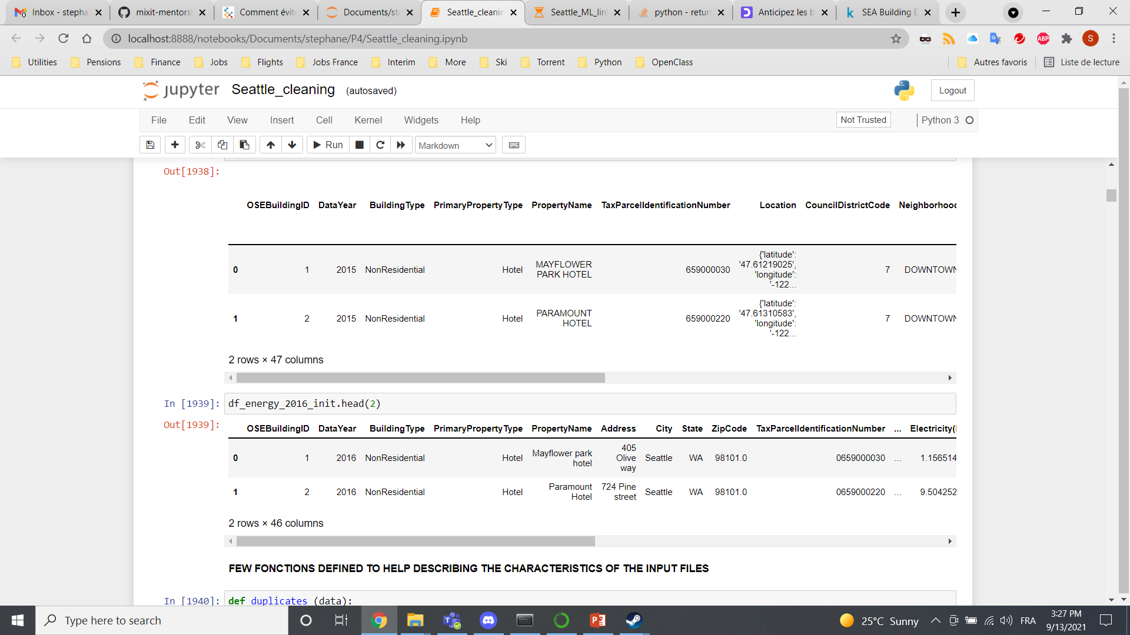
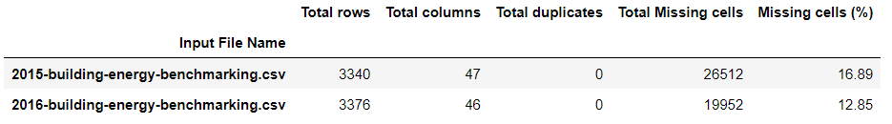
Data set available
SEA Building Energy Benchmarking is an open database from the city of Seattle.
df_data = pd.read_csv (“2015-building-energy-benchmarking.csv")
df_data.head(2)

Slide 6
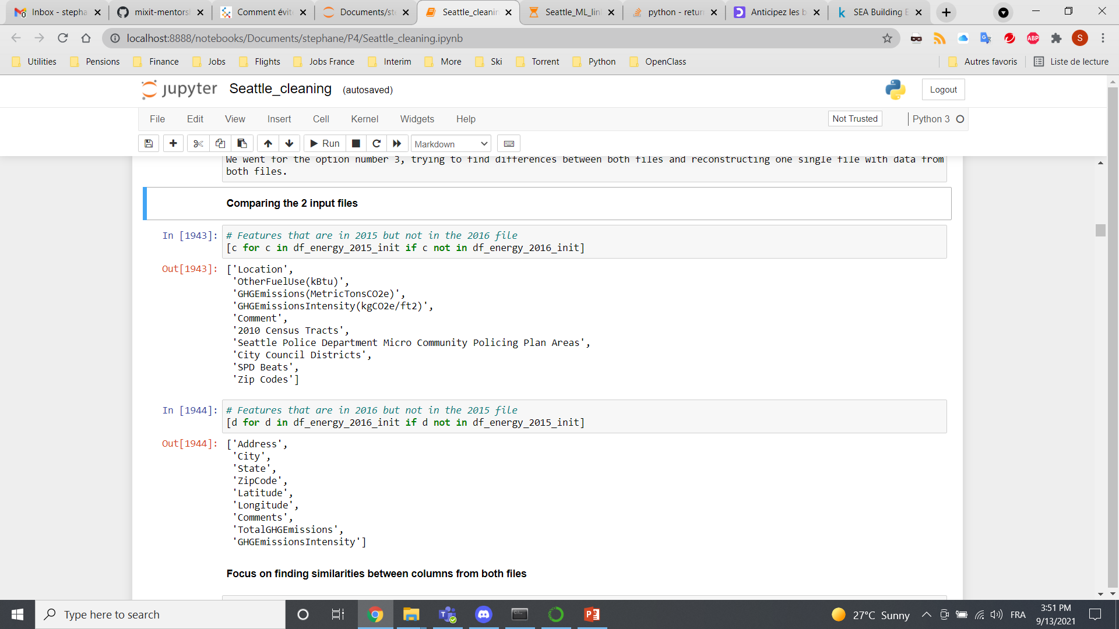
Data cleaning Phase 1: Differences focus
Features in 2015 but not in 2016
Features in 2016 but not in 2015
Split of the json "Location" column
Same units?
Features related
to crime or safety
=
drop
Harmonization of both data sets

Slide 7
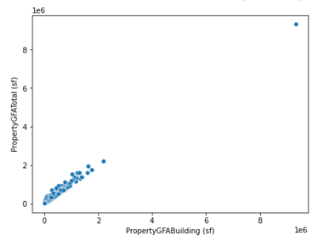
Data cleaning Phase 2: Similarities focus
Drop redundant categories: GHGEmissionsIntensity = GHGEmissionsIntensity(kgCO2e/ft2)
TotalGHGEmissions = GHGEmissions(MetricTonsCO2e)
Concatenate both files (6695 rows × 47 columns)
Converting strings in titlecase str.title() for homogeneity between both files
Drop Weather Normalized WN features (SiteEUIWN, Source EUIWN & SiteEnergyUseWN)
Categories with different units for Electricity and Natural Gas (kBtu over kWh and therms)
Focus on non-Residential Drop Building Type = Multifamily, Campus
Negative data removed, targets (SiteEnergyUse & GHG Emissions) values = 0 removed
Area outlier removed:
University of Washington
(x5 range)
+
Quantile detection
0.05% < dataset < 99.5%

Slide 8
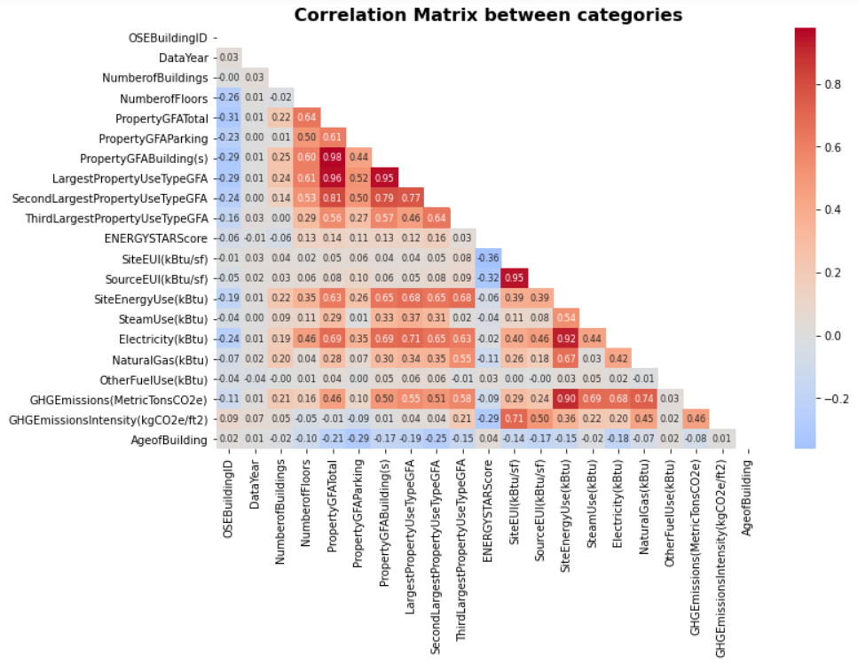
Data cleaning Phase 3: Feature collinearity
Feature Engineering: drop features that are highly correlated with each other by creating new inputs
Data leakage happens when your training data contains information about the target
DO NOT USE
Electricity(kBtu), NaturalGas(kBtu),
SteamUse(kBtu), OtherFuelUse(kBtu)
Our 2 targets
Multicollinearity reduces the precision of the estimated coefficients, which weakens the statistical power of the regression model.

Slide 9
Feature Engineering
Features dropped
Relationship
Features created
YearBuilt
LargestPropertyUseTypeGFA
SecondLargestPropertyUseTypeGFA
SecondLargestPropertyUseType
ThirdLargestProperty UseTypeGFA
ThirdLargestProperty UseType
PropertyGFAParking
PropertyGFABuilding(s)
DataYear – YearBuilt
PropertyGFATotal / NumberofBuildings
PropertyGFATotal / NumberofFloors
PropertyGFABuilding / PropertyGFATotal
PropertyGFAParking / PropertyGFATotal
AgeofBuilding
MeanBuildingGFA
MeanFloorGFA
BuildingGFApct
ParkingGFApct

Slide 10
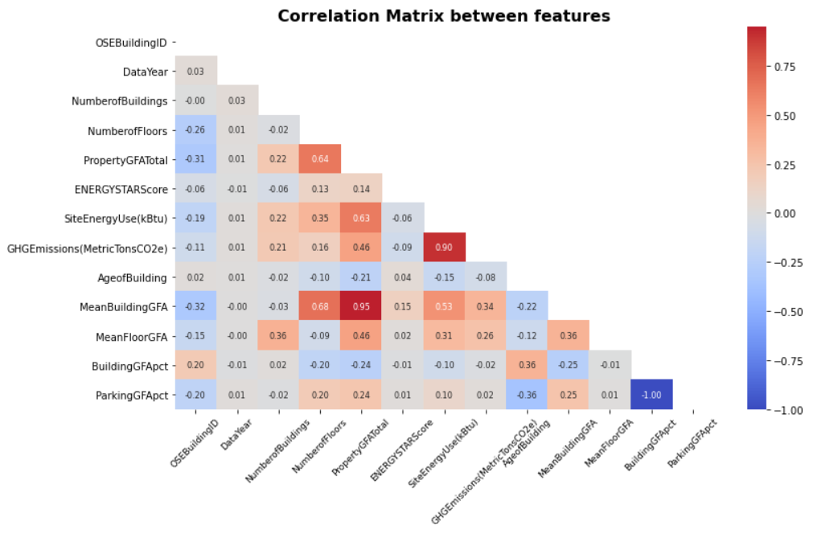
Final Cleaning Phase
Not critical column:
OSEBuildingID
PropertyName
Address
City
State
ZipCode
Outlier
YearENERGYSTARcertified
ENERGYSTARScore
Pearsons coefficients < 0.7, multicollinearity reduced.
End of cleaning phase: From 6695 rows × 47 columns 3173 rows x 17 columns

Slide 11
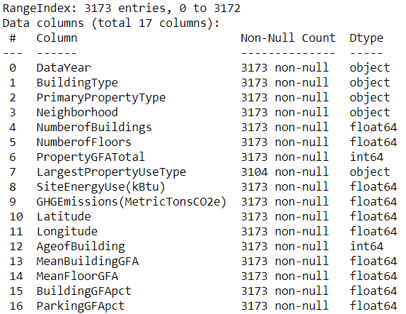
Dataset pre-preparation
scaler = StandardScaler()
categorical_transformer = OneHotEncoder()
preprocessor = ColumnTransformer(transformers=
[('num', scaler, num_data ),
('cat', categorical_transformer, cat_data)])
Dataset split (80% training, 20% testing)
X_train, X_test, Y_train, Y_test = train_test_split(X, Y, test_size=0.2, random_state=42)
num_data: 10 numerical features = int or float
cat_data: 5 categorical features = object
2 numerical targets

Slide 12
Model Building & Training
Phase 1
Phase 2
Phase 3
Data Preparation
Cleaning
Featurization
Standardization
Encoding
Transformation
Test/Train set
Model Building
& Training
Hyper-parameter tuning (Gridsearchcv)
Automatic model selection
Models testing
Models comparison
Model Deployment
Best model selected
Predictions
Site Energy Use
GHG Emissions
DATA

Slide 13
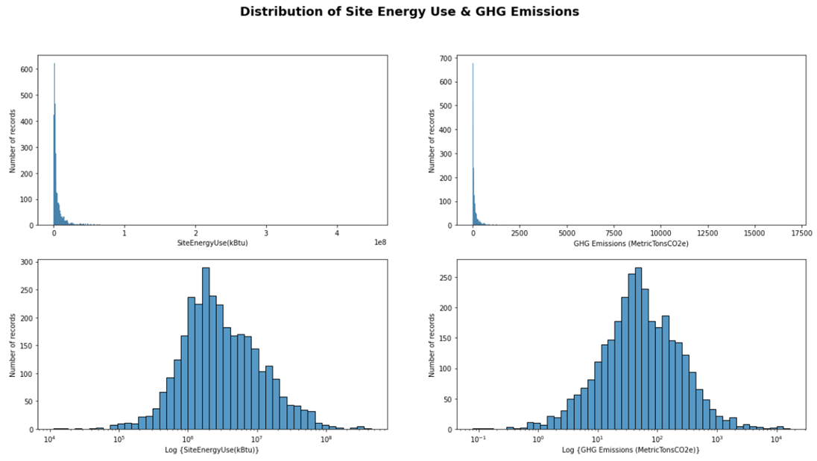
Machine Learning Models Evaluation
Impact of Linear v Log scale
Dummy (baseline)
Linear
Lasso
Ridge
ElasticNet
SVM
KNN
Random Forest
XGBoost
Log transform is used to convert a skewed distribution to a normal / less skewed distribution.
Data normalization
Is it worth transforming into log?
Do we get better scoring metrics?

Slide 14
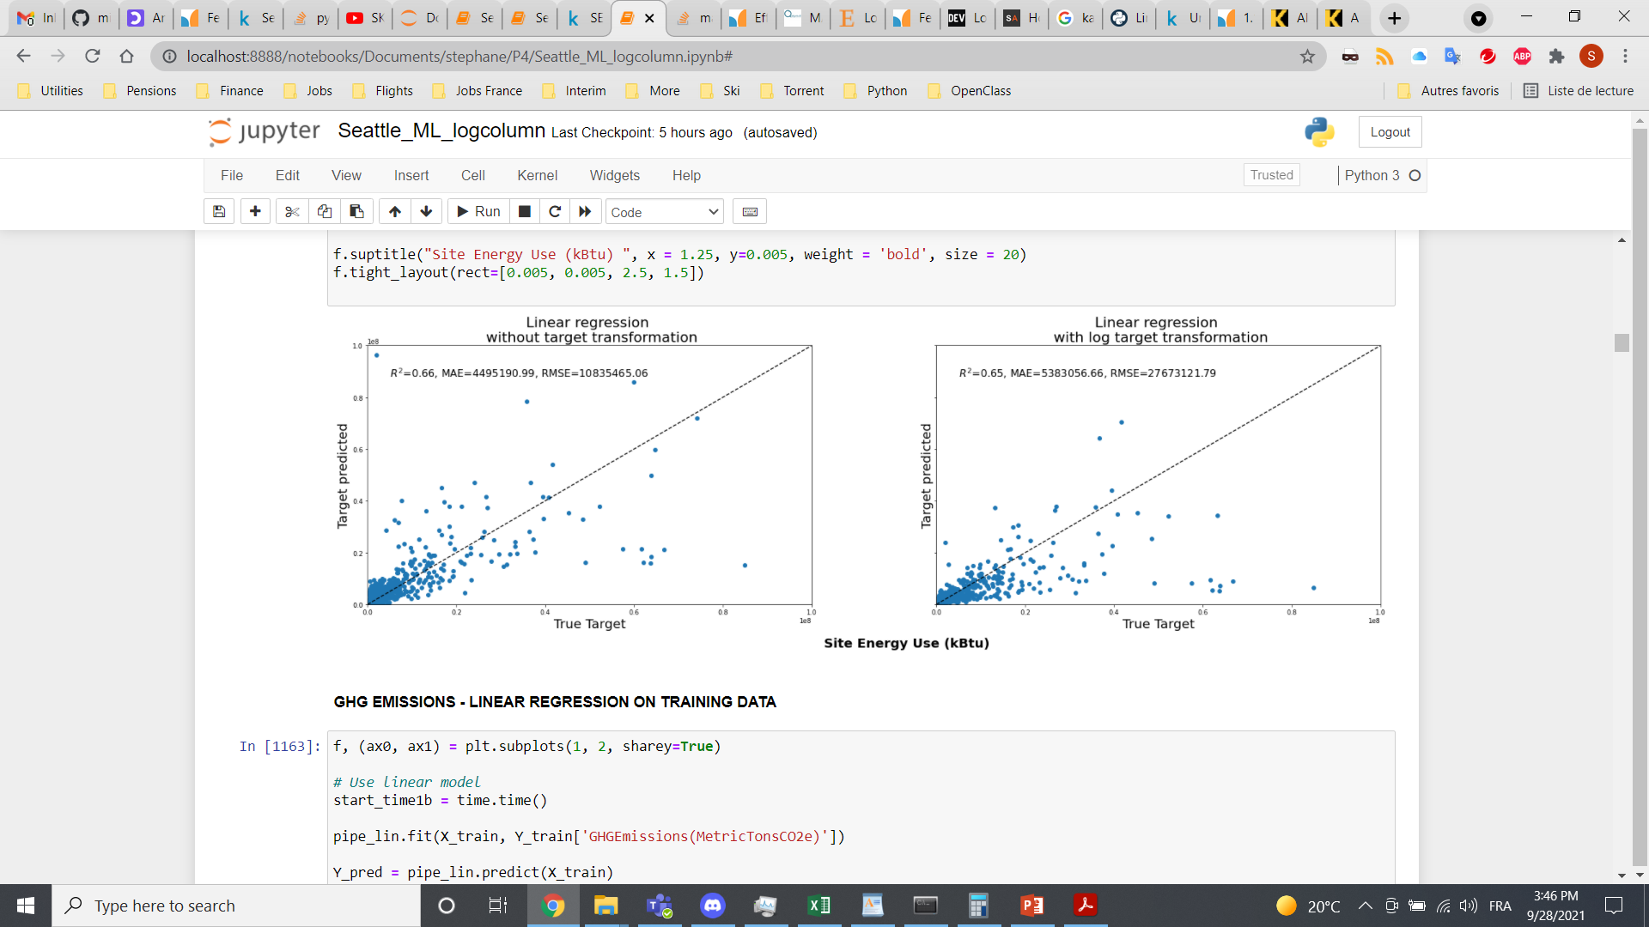
Linear regression
regressor = LinearRegression()
regressor.fit (X_train, Y_train) # training the algorithm
Y_pred = regressor.predict (X_train/test) # making predictions
Metrics chosen
R2: Coefficient of determination
MAE: Mean Absolute Error
RMSE: Root Mean Square Error
Log scale
np.log1p
+ expm1 for results on same scale
Linear scale

Slide 15
Hyper-parameters optimization Gridsearchcv (SEU)
 | ElasticNet | KNN | RandomForest | XGBoost
Hyper-Parameters | alpha = [0.0001, 0.001, 0.1…10] | Neighbors = [3, 5, 7…15, 55] | Max_features = [auto, sqrt, log2] | Nb_estimators = [0, 1000, 10]
 | L1_ratio = [0.001, 0.01, 0.1, 0.5, 0.95] |  | Max_depth = [5, 15, 25, 50, 100] | Learning_rate = [0.001, 0.01, 0.1, 0.2, 0.3]
 | Max_iter = [10, 50, 100, 1000, 10000] |  | Min_samples_split = [2, 5, 10] | Max_depth_child = [6, 20, 1]
 |  |  | Min_sample_leaf = [1, 2, 5, 10] | Min_child_weight = [1, 10, 1]
 |  |  | Bootstrap = [False, True] | gamma = [0, 10, 0.1]
Best hyper-parameters returning the lowest MAE for each model

Slide 16
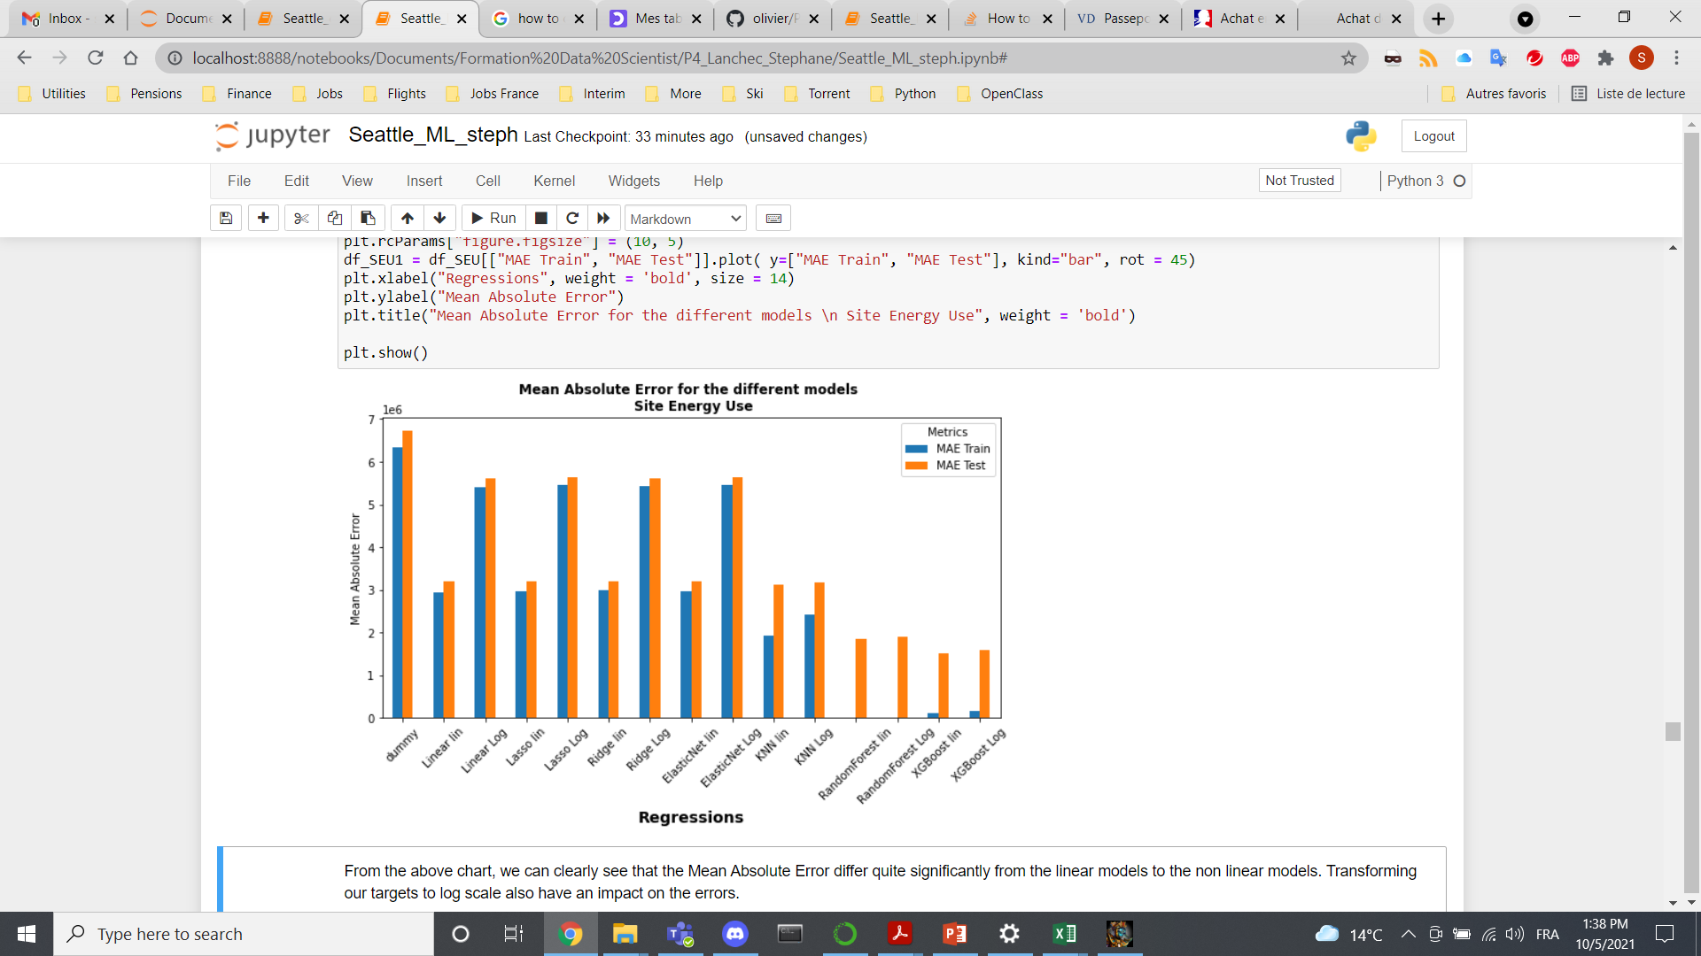
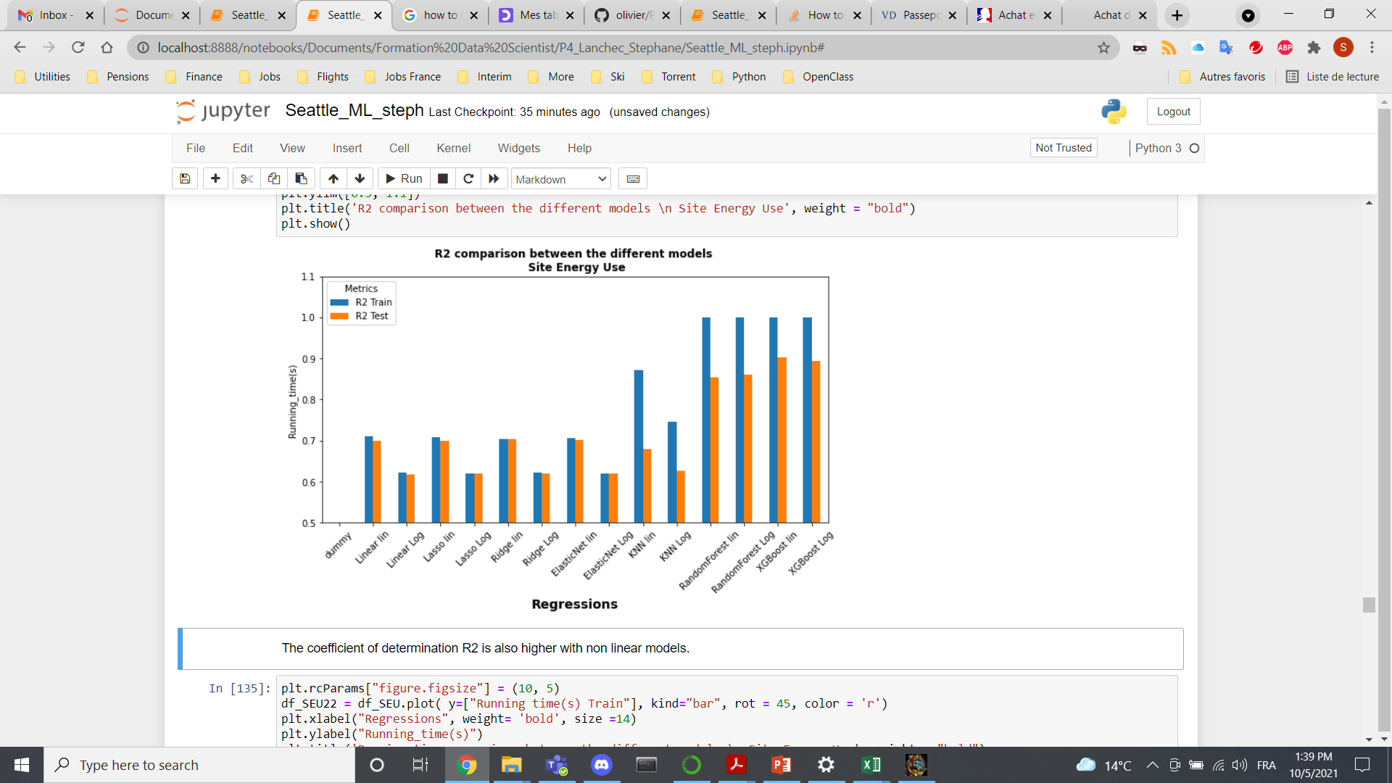
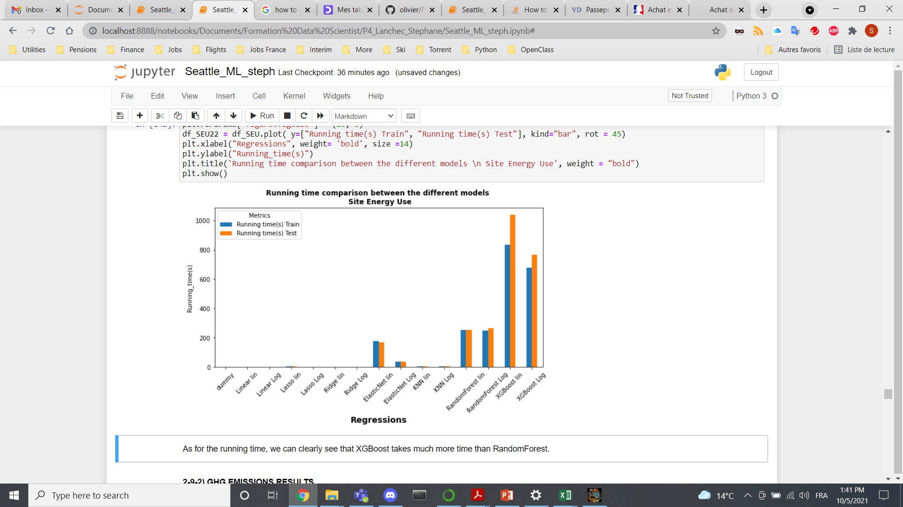
Results – Models comparison (Site Energy Use)
 | MAE | R2 | Running Time (s)
ElasticNet | 3.2x106 | 0.70 | 50.8
KNN | 3.1x106 | 0.68 | 4.56
Random Forest | 1.9x106 | 0.85 | 283.4
XGBoost | 1.5x16 | 0.90 | 1109.6

Slide 17
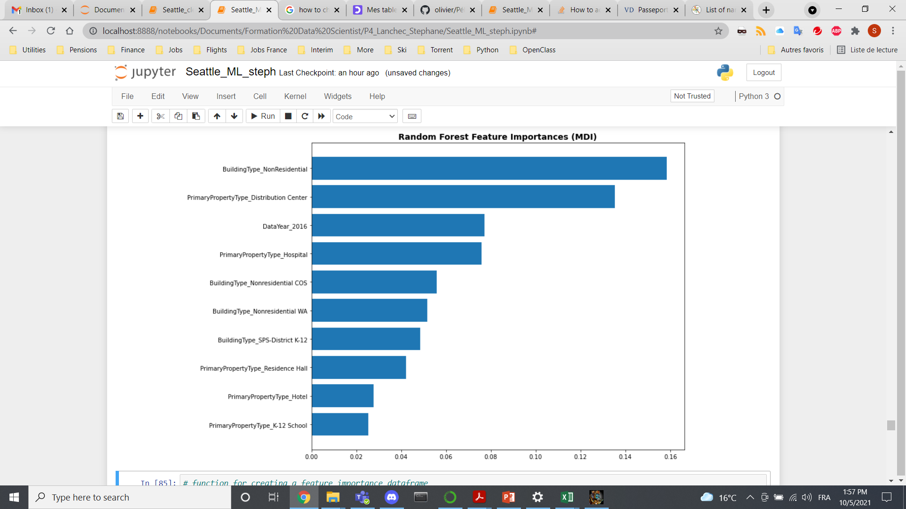
Feature Importance
Most important features
Building Type
Primary Property Type

Slide 18
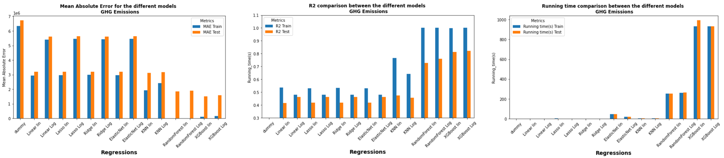
Results – Models comparison (GHG Emissions)
 | MAE | R2 | Running Time (s)
ElasticNet | 103.9 | 0.42 | 34.6
KNN | 95.1 | 0.47 | 4.4
Random Forest | 60.7 | 0.72 | 263.4
XGBoost | 46.7 | 0.81 | 924.5

Slide 19
Model Deployment
Phase 1
Phase 2
Phase 3
Data Preparation
Cleaning
Featurization
Standardization
Encoding
Transformation
Test/Train set
Model Building
& Training
Hyper-parameter tuning (Gridsearchcv)
Automatic model selection
Models testing
Model comparison
Model Deployment
Best model selected
Predictions
Site Energy Use
GHG Emissions
DATA

Slide 20
SEU & GHG Predictions
Best model: RandomForest
SEU predictions
I
Data set
Preprocessing
Independance
GHG predictions
 | I | II
MAE | 60.7 | 48.6
R2 | 0.72 | 0.84
II
Data set
Preprocessing
SEU predictions
GHG predictions
Dependance

Slide 21
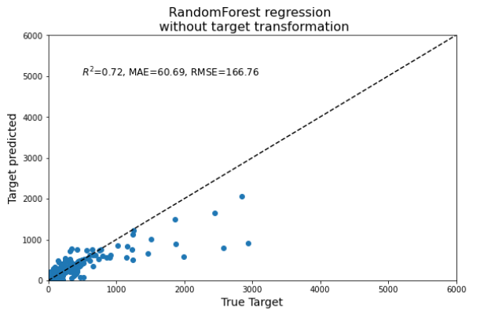
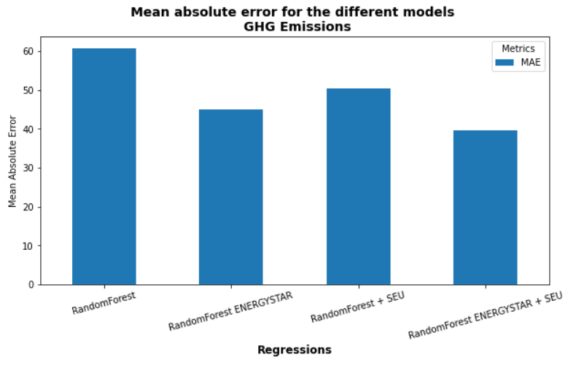
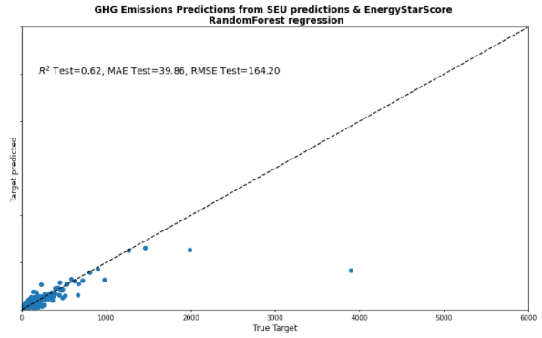
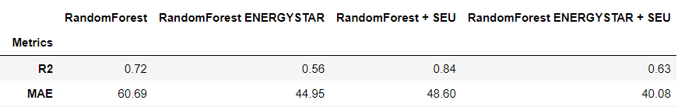
Impact of ENERGYSTARScore

Slide 22
Conclusion
RandomForest proved to be the best model (Running time + performance)
Using Site Energy Use predictions improve the metrics
ENERGYSTARScore has a positive impact on our metrics – Economical budget to take into account
City of Seattle could forecast GHG Emissions for future buildings with a Mean Absolute Error of 40 MetricTonsCO2e
Going further
Use VIF (Variance Inflation Factor) for collinearity indicators
Feature importance & noise reduction by feature selection
Check Early stopping for XGBoost (not available in RandomForest)
Precision in errors

